Slide 1
Mortgage payments survival analysis
Section 2 – Team 3

Slide 2
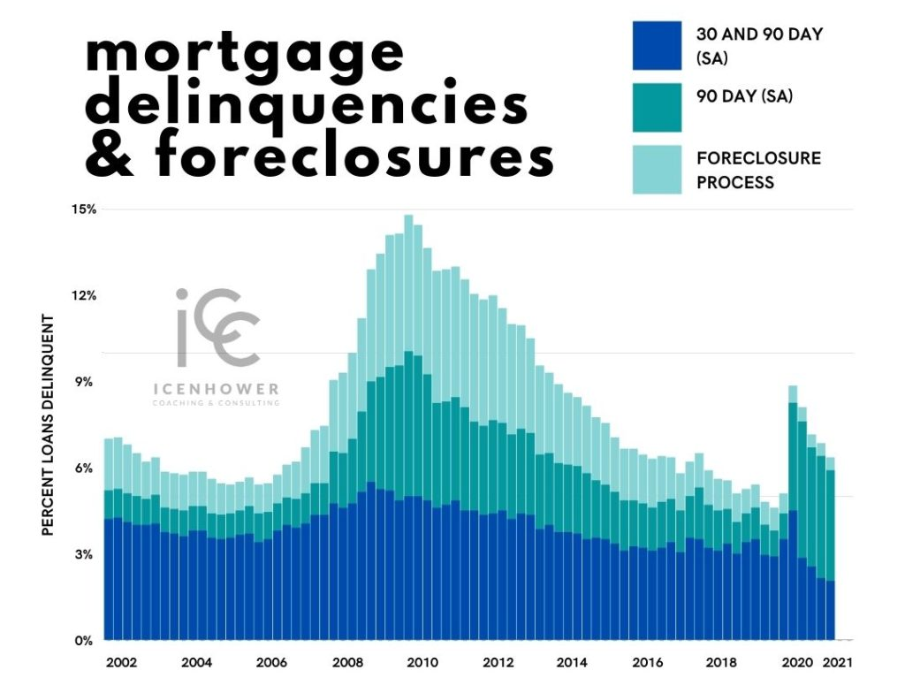
INDUSTRY OVERVIEW
$374 K
Average price of a house in US in 2021
More than
62%
US citizens carry a mortgage
$1.61 Trillion
8.8%
Housing loans issued in 2021
rise from 2020

Slide 3







MEET THE TEAM
CHETAN
SOLANKI
Manideep
sharma
Rajib
mahato
Hemanth sai ram challagolla
Apoorva
Singh
UTKARSH
BAJAJ
DIEGO carlos chavez

Slide 4
Industry overview
Business problem
Exploratory DATA Analysis
Survival analysis and modeling
01
02
AGENDA
03
04
05
Recommendation and learnings

Slide 5
BUSINESS PROBLEM
To estimate the loan default probability and analyze how customer attributes impact this rate
PROBLEM
Performed survival and hazard analysis to quantify the impact of debt ratio, credit score and refinancing on the loan default rate
APPROACH

Slide 6
INTRODUCTION
EXPLORATORY DATA ANALYSIS
Mercury is the closest planet to the Sun and the smallest one in the Solar System—it’s only a bit larger than the Moon

Slide 7
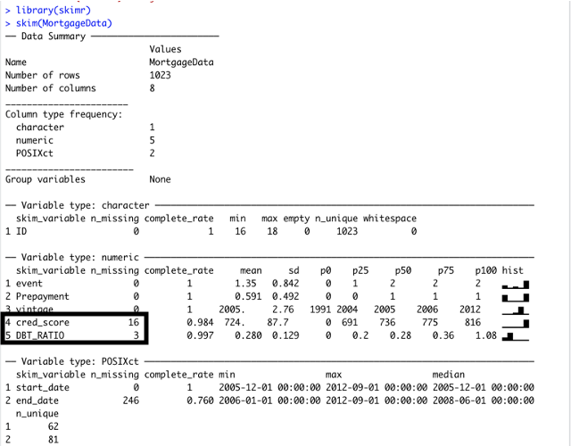
Data Cleaning
16 null values in credit score
3 null values in Debt Ratio
These records were removed as they are very low in number

Slide 8
Customer distribution
Total: 1023 customers
59%
customers have prepaid their mortgage loan
17%
customers have defaulted during the period of interest
24%
customers do not have details about payment status

Slide 9
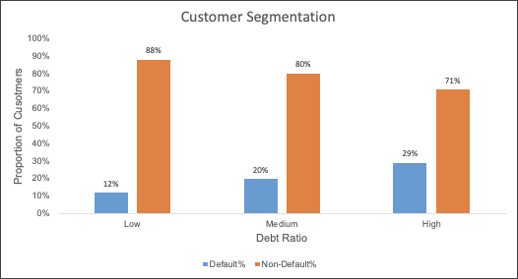
DEBT to value RATIO
Low: <=0.25
Med: 0.26 - 0.50
High: >=0.5
The proportion of customers defaulting on loan is highest in High Debt ratio category.

Slide 10
Loan Duration
There are almost equal proportion of defaulting and non-defaulting customers when the loan duration is between 41-50 months

Slide 11
Credit score
Poor: <=579
Fair: 580 - 669
Good: >=670
Customers with fair or good credit score have low proportion of loan defaulters

Slide 12
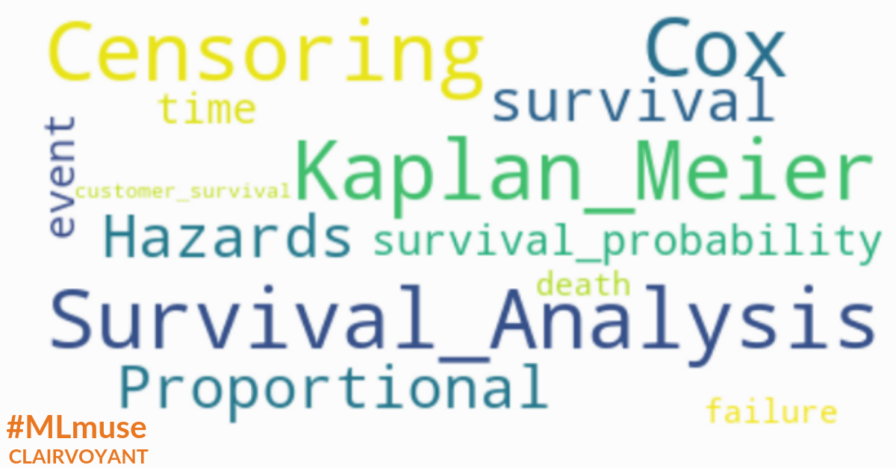
INTRODUCTION
Survival analysis
Mercury is the closest planet to the Sun and the smallest one in the Solar System—it’s only a bit larger than the Moon

Slide 13
How this analysis helps us?
Predict likelihood of default at different time periods
Measure influence of other factors on the default rate
Quantify relationship of other predictors with default
Can incorporate censored data

Slide 14
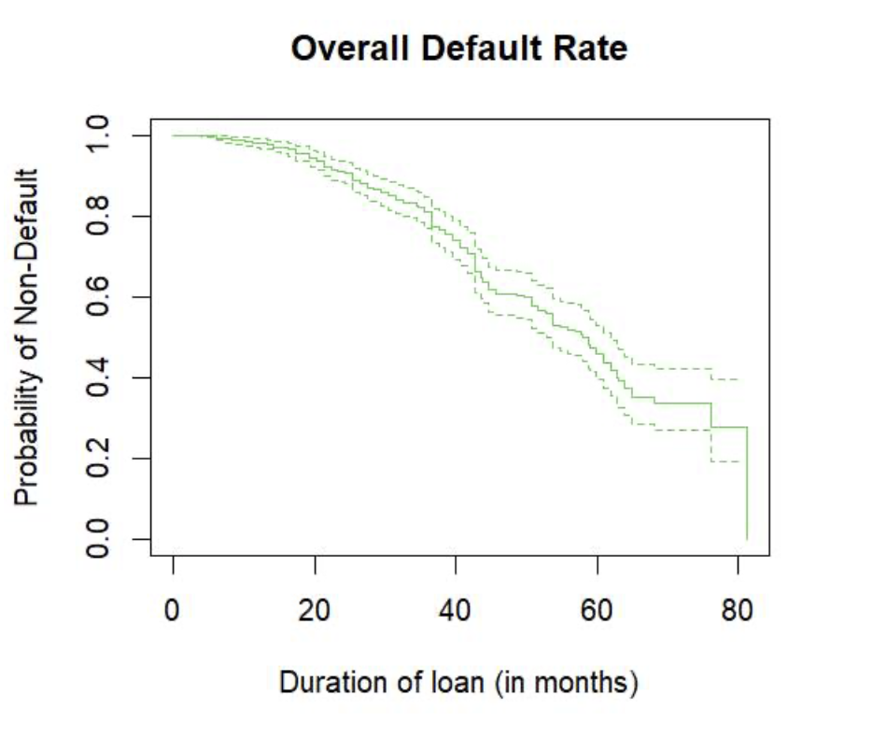

KM survival curve
50%
Chance that a customer will not default until 58th month
30%
Chance for not defaulting until 75th month
Lenders can accrue lot of interest by this period
Notes:
Drop at 80: 30% customers are at a risk of defaulting beyond 75th month

Slide 15
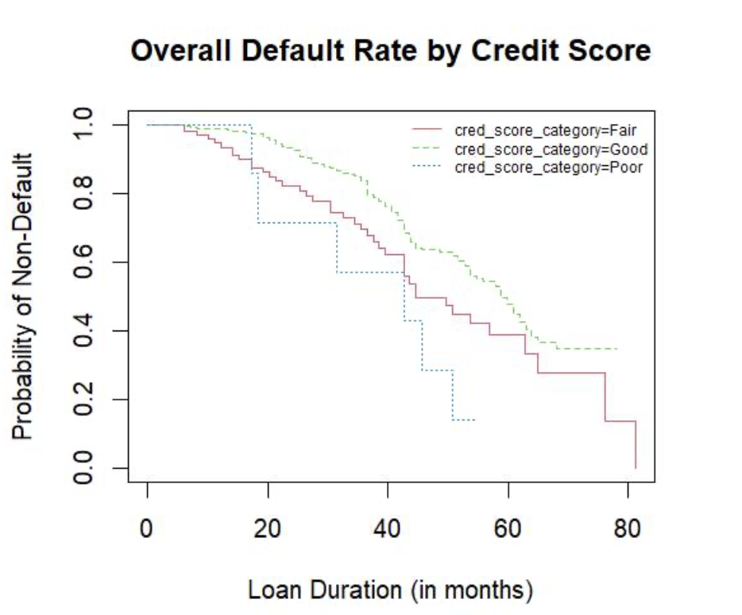
IMPACT OF CREDIT SCORE ON SURVIVAL RATE
Credit score
Default Rate
Customers with Good Credit score have lower chances of being Default at any given period as compared to Fair and Poor
Notes:
The probability of non-defaulting 50 months is 30% for customers with poor credit score; conversely, if you are in the good credit score group, your probability of surviving the same time is slightly more than 60%. The steepness of the curve is determined by the survival durations.

Slide 16
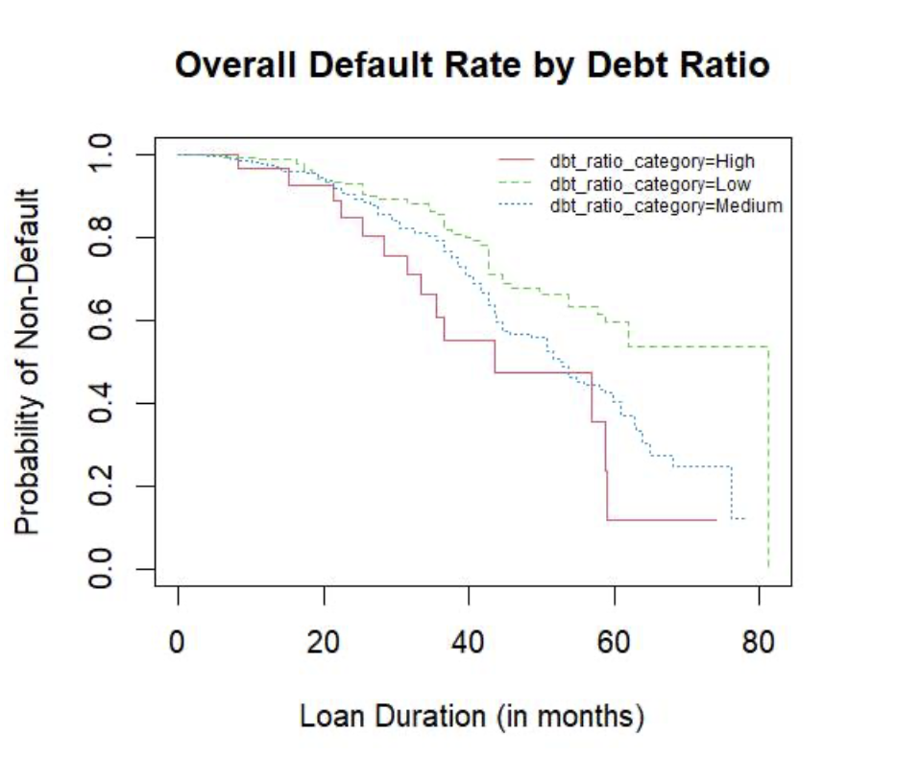
IMPACT OF DEBT RATIO ON SURVIVAL RATE
Debt Ratio
Default Rate
Customers with High Debt Ratio have higher chances of being Default at any given period as compared to Low and Medium

Slide 17
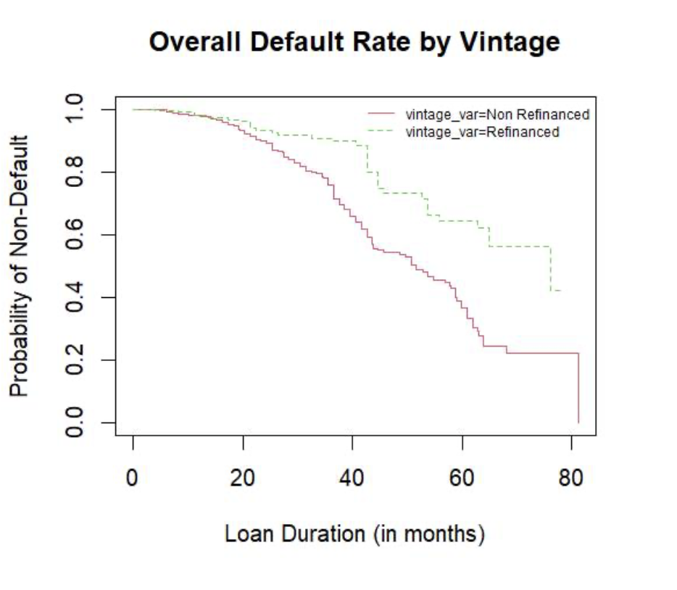
IMPACT OF refinancing on survival RATE
Refinancing leads to
Default Rate
Customers who have refinanced are less likely to default later (post 2 years) than customers with original loan terms.

Slide 18
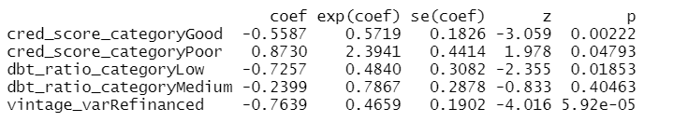
Ideal customer has good credit score-low debt ratio-refinanced
Cox proportional model / hazard analysis
43%
Reduction in Default rate
52%
Reduction in Default rate
Vintage period
Good
Low
Original terms
Fair
Debt Ratio
High
Credit Score
139%
Increase in Default rate
22%
Reduction in Default rate
53%
Reduction in Default rate
Poor
Medium
Refinanced
Model results
Notes:
KM survival is used to test whether there is a difference between the survival times of different groups but it does not allow other explanatory variables to be taken into account.
Cox's proportional hazards model is analogous to a multiple regression model and enables the difference between survival times of particular groups of patients to be tested while allowing for other factors.

Slide 19
RECOMMENDATIONS

Slide 20




Key recommendations and conclusions
The company should not lend to customers with Poor credit score when the loan duration is beyond 40 months
Customers with High Debt ratio are more prone to Default because of low down payment on their loans
It’s favorable for the lenders to lend the customers who are refinancing the loan. Default rate lowers by 53% if it’s refinanced
More diverse data is better! Significance of the attributes will be robust if backed by more customers data

Slide 21
Thank you

Slide 22
APPENDIX

Slide 23
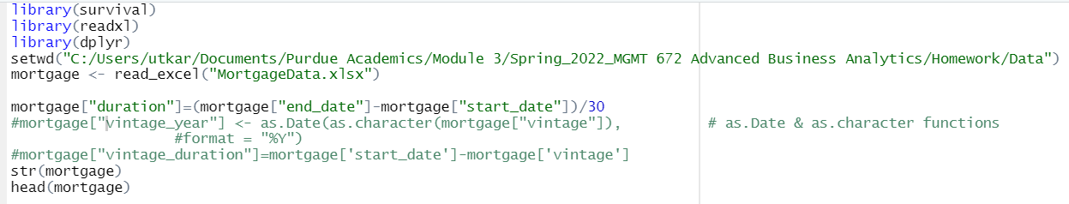
CODE SNIPPETS-I
READING DATA
KM Model

Slide 24
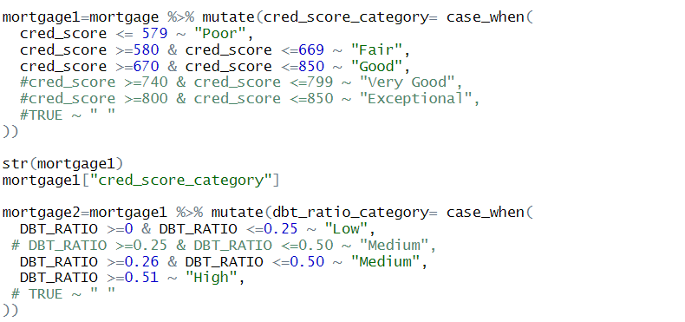
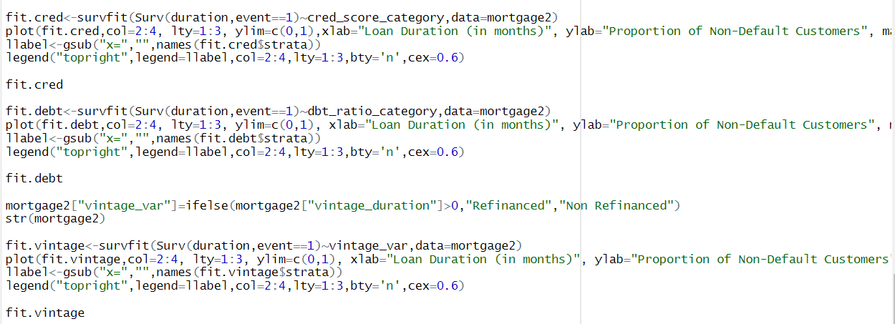
CODE SNIPPETS-II
DATA MANIPULATION
KM MODEL WITH OTHER VARIABLES

Slide 25
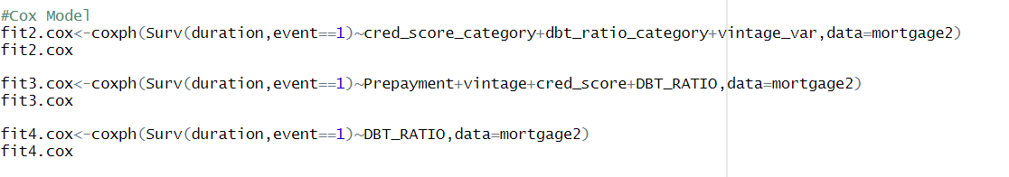
CODE SNIPPETS-III
COX MODEL

